Slide 1
Exploring the Impact of Choice Award Books on Reader Stress Through NLP
Data Analytics
April 2024
TENG Xiaobo

Slide 2
TABLE OF CONTENTS
01
02
03
Data Collection and Preparation
Collection, cleaning, and structuring of data to ensure analysis readiness
Analysis and Visualization
Definition, exploration, and visualization of data to highlight critical insights
Machine Learning
Feature engineering, model training, and evaluation to derive advanced insights

Slide 3
Objective
Exploring the Impact of Literary Quality on Reader Stress
Purpose: Investigate the relationship between award-nominated books and reader stress levels.
Method: Analyse reviews related to these books to determine the presence of stress.
Goal: Understand if literary works correlate with the emotional impact they have on readers.

Slide 4
PROJECT PLANNING
Gather data
Initial EDA
Clean data
Create API and documentation
Create database in MySQL
Machine Learning
ERD
Advanced EDA

Slide 5
Data Collection and Preparation
O1.
Data Foundation Building

Slide 6
DATA GATHERING
WEB SCRAPING
API
Best Books 2023 — Goodreads Choice Awards
(2019-2023)
Books API | Dev Portal (nytimes.com)
(2019-2023)
OPEN SOURCE
BIGQUERY
Stress Analysis in Social Media (kaggle.com)
Google Cloud console

Slide 7
RAW DATA
(1778,14)
(17708,3)
(13530,7)
Book information
Reviews
Best Sellers information
5 csv files
5 json files
5 json files

Slide 8
DATA CLEANING
Book information
Reviews
Drop “ISBN”: too much “not found”
Drop records “ratings_count”=0
Extract “publish_date”:
ex. “First published September 10, 2019” → ” 2019-09-10”
Add “award_id”
Refine “genre”: based on the award
Functions for information extraction from JSON files
Remove the date from review_text:
Ex. August 10, 2022“Purposeful awkwardness” is how...
→ “Purposeful awkwardness” is how I can describe...

Slide 9
TABLES FOR DATABASE CREATION
- book_info: books information of Choice Award
- bestsellers: books information of NYT bestsellers
- books_title: list of the titles of all the books
- choice_award: category of award of each year
- lists_bestsellers: lists of NYT bestsellers
- reviews: first 10 reviews for each award book

Slide 10
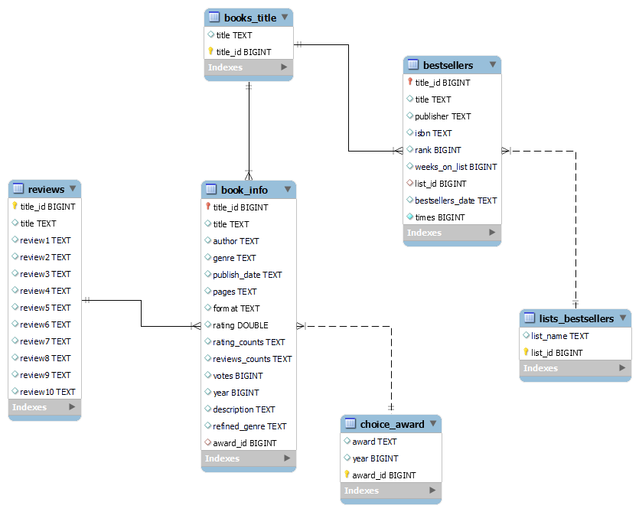
ENTITY RELATIONSHIP DIAGRAM (ERD)

Slide 11
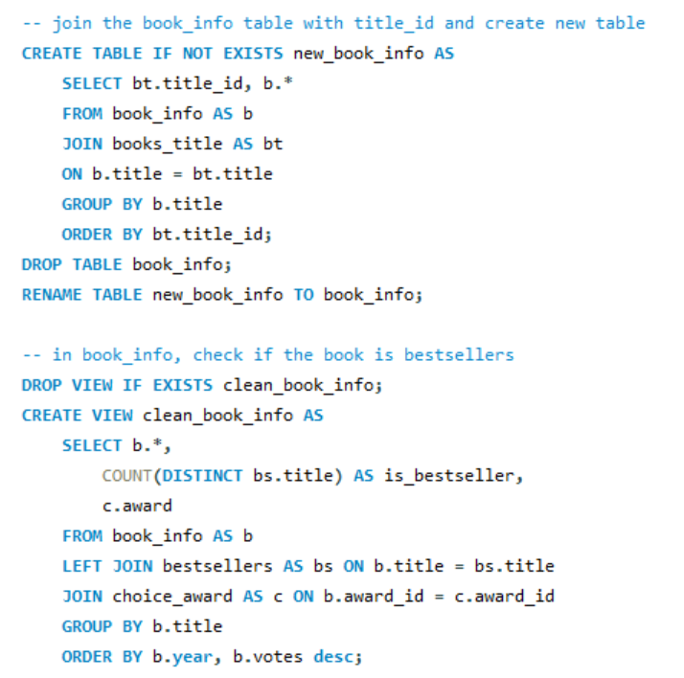
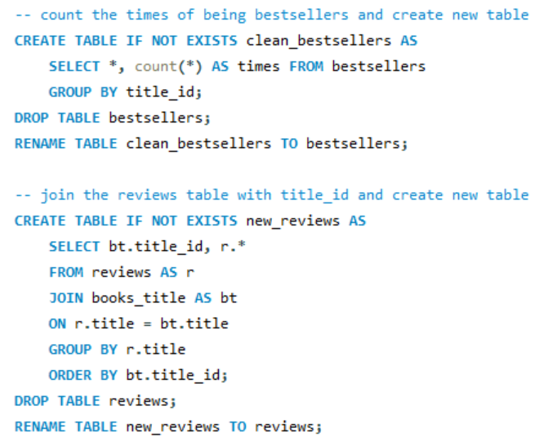
EXAMPLES SQL QUERY

Slide 12
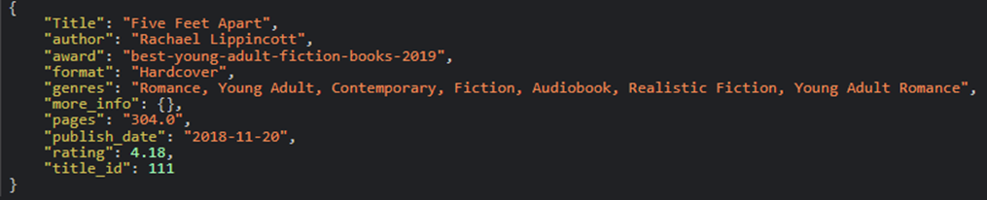
API DEVELOPMENT
METHOD | ENDPOINT | DESCRIPTION
GET/ | /v1/books | Retrieves a list of all books
GET/ | /v1/books/{title_id} | Retrieves a specific book by title_id
GET/ | /v1/awardslist | Retrieve all the lists of ChoiceAwards from 2019 to 2023
GET/ | /v1/awardslist/{year} | Access list of award of a specific year

Slide 13
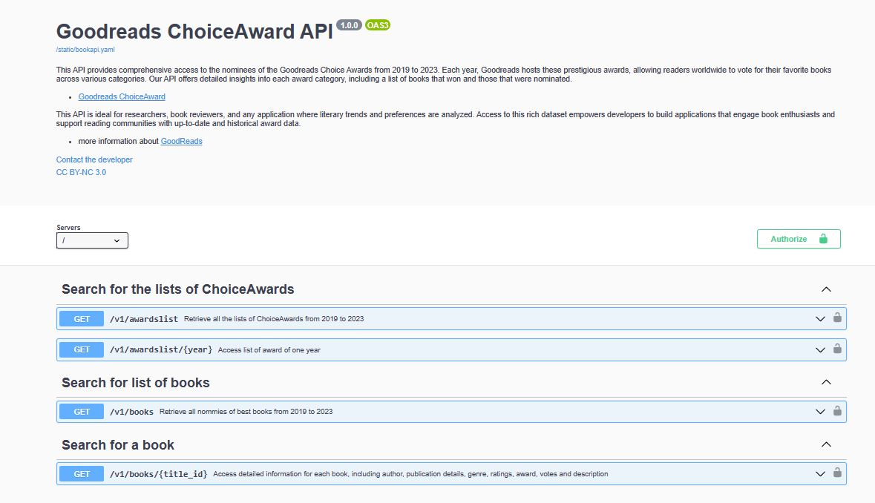
DOCUMENTATION
Swagger UI
We documented the API endpoints using Swagger, which provides an interactive UI for exploring and testing the API.

Slide 14
Analysis and Visualization
02.
Insight Discovery Through Data

Slide 15
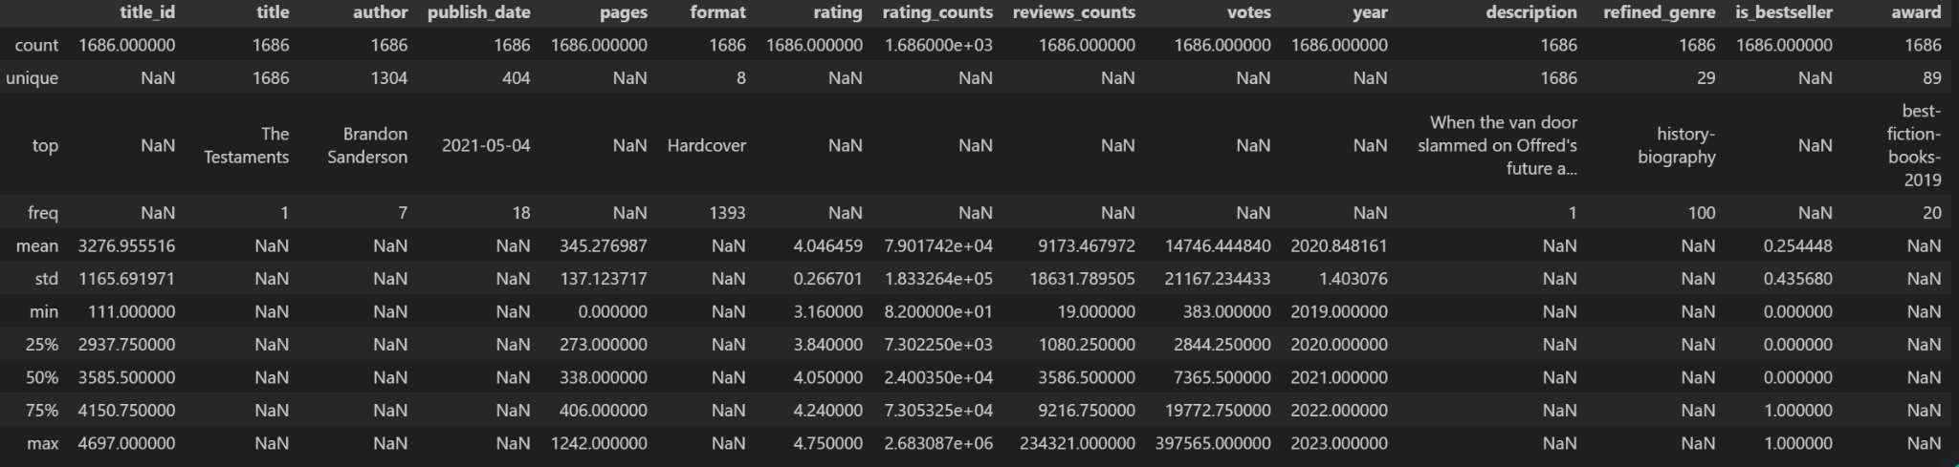
Initial Exploratory Data Analysis (EDA)
BOOK INFO
REVIEWS WITH STRESS
Shape
(1686,15)
Shape
(16860,6)
book_info.describe(include='all')

Slide 16
1686 books by 1304 authors
397,565
4.72
Brandon Sanderson - 7 books
votes
Fourth Wing - Rebecca Yarros
How the Word Is Passed: A Reckoning with the History of Slavery Across America - Clint Smith
The Only Plane in the Sky: An Oral History of 9/11 - Garrett M. Graff

Slide 17


Proportion
Award-Nominated Books:
Bestsellers vs Non-Bestsellers
Reader Reviews:
Stress vs. No-Stress
Bestsellers
Stress
25.4%
11.2%
Non-Bestsellers
74.6%
No-Stress
88.8%

Slide 18
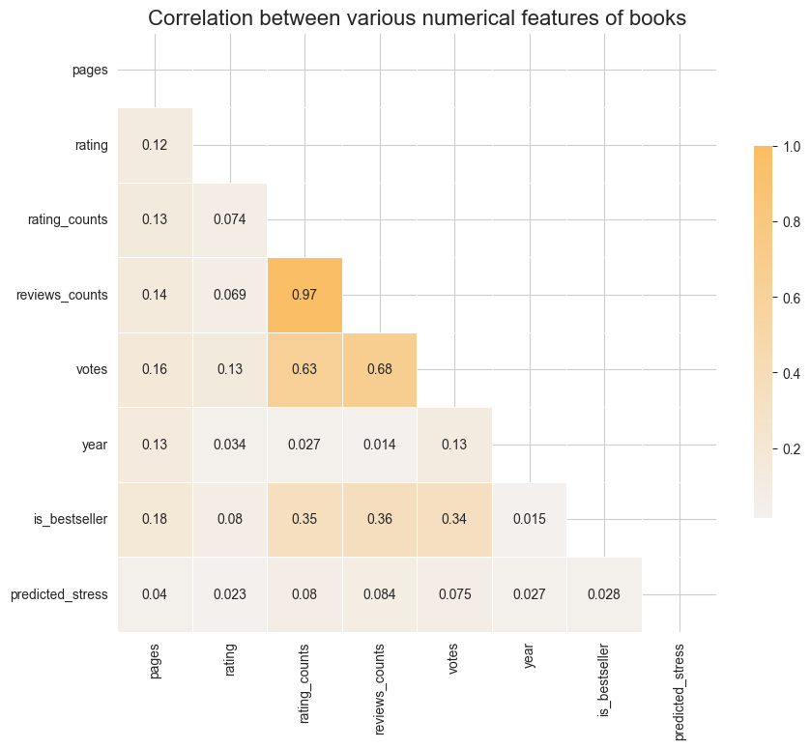
Correlation

Slide 19
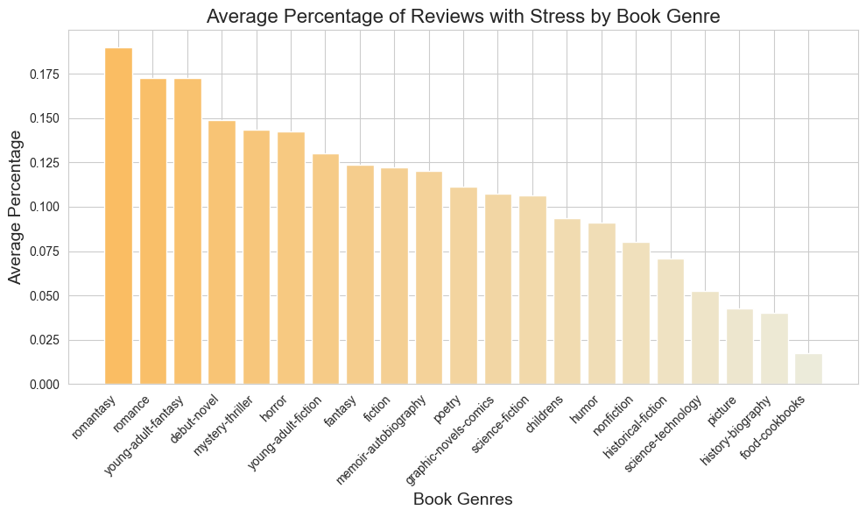
Genre-Specific Stress Analysis
Romantasy | 19.0%
Romance | 17.3%
Young-adult-fantasy | 17.2%
Debut-novel | 14.9%
Mystery-thriller | 14.3%

Slide 20
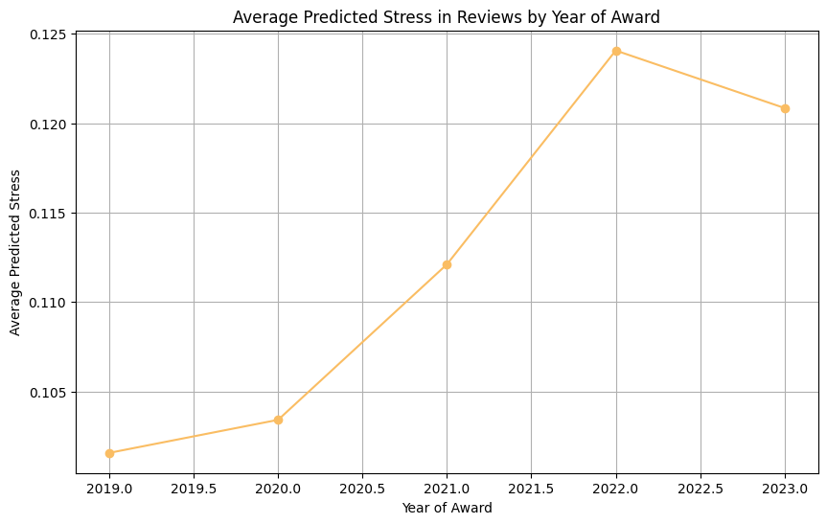

Slide 21

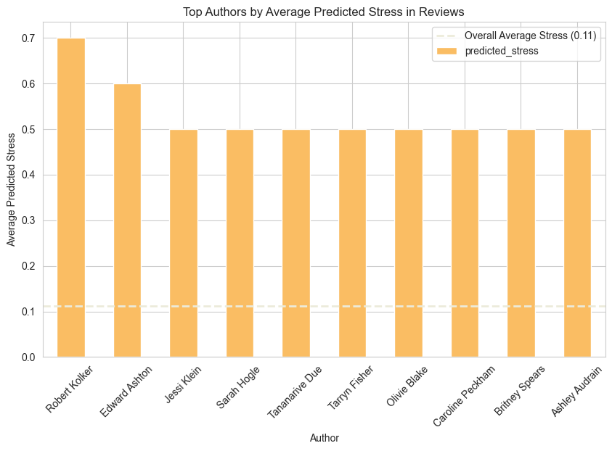
Hidden Valley Road:
Inside the Mind of an American Family
Robert Kolker
Robert Kolker
Description:
The heart-ending story of a mid-century American family with twelve children, six of them diagnosed with schizophrenia, that became science's great hope in the quest to understand the disease.

Slide 22
Machine Learning
O3.
Machine Learning Implementation

Slide 23
DATASET
A dataset of lengthy multi-domain social media data for identifying stress from 10 different categories of Reddit communities.
shape
relationships
anxiety
ptsd
assistance
homeless
almosthomeless
domesticviolence
survivorsofabuse
stress
food_pantry
3553 records ; 116 fields
target
stress[‘stress’].value_counts()
classification
stress=1 : 1857 stress=0: 1696

Slide 24
PROGRESS GENERAL OVERVIEW
Preparation of text:
Tokenize text
Remove stopwords
Lemmatize
“stress” = 1
01
“It cleared up and I was okay but. On Monday I was thinking about humans and how the brain works and it tripped me out I got worried that because I was thinking about how the brain works that I would lose sleep and I did. That night was bad just like last time. Also yesterday my sleep was bad I woke up like every hour of the night just like last time. I got kind of scared like I did last time but this time I think that this is fake life which is absurd but I just think about it then get really scared then I think rationally then calm down.”
Model training:
LogisticRegression
SVM
RandomForest
02
Evaluation:
Precision score
Recall score
f1-score
03

Slide 25
TEXT PREPARATION for NLP
Raw Text
Tokenization
& Lowercasing
Stop words Removal
Lemmatization
Vectorization
I read the first chapter of Gilded Wolves and was like 'ok, I need to clear like 2 days because once I start this, I won't be able to put it down.
["i", "read", "the", "first", "chapter", "of", "gilded", "wolves", "and", "was", "like", "ok", "i", "need", "to", "clear", "like", "2", "days", "because", "once", "i", "start", "this", "i", "won't", "be", "able", "to", "put", "it", "down"]
["read", "first", "chapter", "gilded", "wolves", "ok", "need", "clear", "2", "days", "start", "this", "won't", "put", "down"]
["read", "first", "chapter", "gilded", "wolves", "ok", "need", "clear", "2", "day", "start", "this", "will not", "put", "down"]
Term | TF-IDF Score
read first chapter glided wolves ok … | 0.23 0.19 0.24 0.31 0.31 0.15

Slide 26
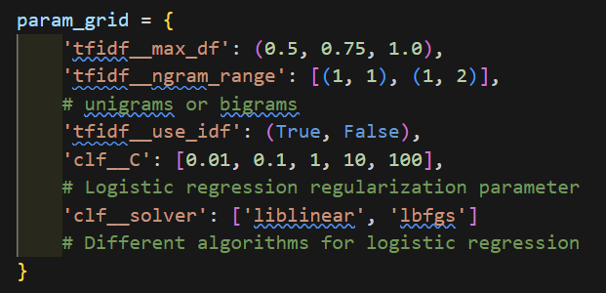
HYPERPARAMETER TUNNING
Grid Search
Comprehensive Testing:
This grid allows for a thorough testing of different combinations to find the best model configuration.
Balanced Approach:
By varying parameters like `ngram_range` and `use_idf`, it balances between word frequency and context relevance.
Optimized Performance:
Regularization and solver choices tweak the logistic regression to optimize for both accuracy and computational efficiency.
Configuration of Hyperparameters for LogisticRegression

Slide 27
EVALUATION
0.75
0.75
0.76
LogisticRegression
SVM
RandomForest
Precision recall f1-score
0 0.73 0.72 0.73
1 0.77 0.77 0.77
Precision recall f1-score
0 0.72 0.73 0.73
1 0.77 0.77 0.77
Precision recall f1-score
0 0.79 0.64 0.71
1 0.74 0.86 0.79

Slide 28
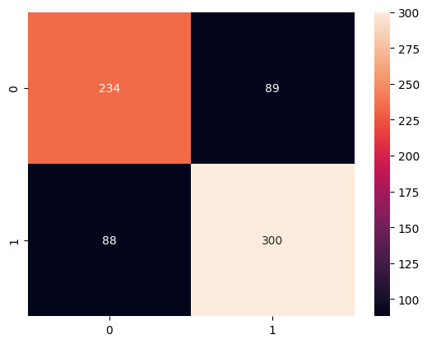
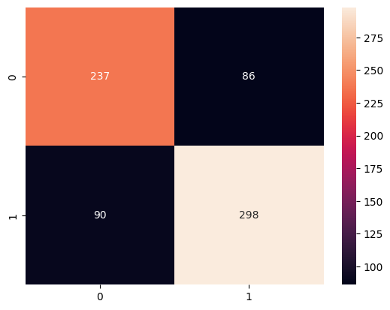
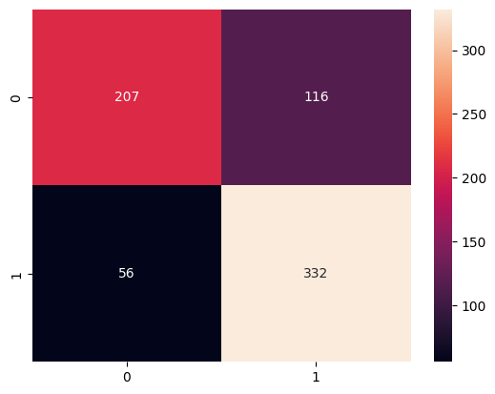
Confusion Matrix
LogisticRegression
SVM
RandomForest

Slide 29
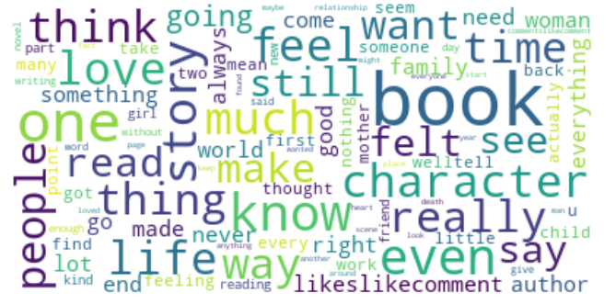
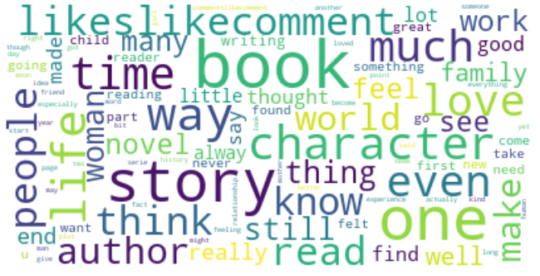
Word Cloud
stress
no_stress

Slide 30
CHALLENGES
Technical Challenges
Data Collection and Quality:
Limited data available for model training affecting the model's predictive capabilities.
Model Selection:
Difficulty in determining the most effective model due to limited data.
Computational Resources:
Constraints on resources resulting in longer run times and limited model evaluation.
Solution Strategies
Optimization of Processes:
Reduced the number of grid search iterations to save on computational time and resources.
Unresolved Issues
Insufficient Data: The quantity of data remains a fundamental limitation.
Ongoing Challenges: Additional issues requiring further investigation to optimize model performance.

Slide 31
NEXT STEP
Collect More Reviews Data:
Expand the scope of data collection to include additional online platforms and social media.
Incorporate reviews from various languages and regions to obtain a broader perspective.
In-Depth Analysis of Book Texts:
Employ natural language processing techniques to analyse the language style and structure of the books.
Identify key chapters and content to understand their impact on reader feedback.
Extract More Features from Text:
Sentiment Analysis: Assess the emotional tone of the book contents, such as positive, neutral, or negative sentiments.
Keyword Extraction: Identify the core themes and frequently occurring keywords within the text.
Semantic Analysis: Understand the deeper meanings of book themes through contextual analysis.

Slide 32
THANKS!
DO YOU HAVE ANY QUESTIONS?
xiaobo.teng93@gmail.com
https://github.com/txiao9331/LitMental.git
Please keep this slide for attribution

